Slide 1
Cargo Shipment Management
Team@ISS

Slide 2
Problem
Imprecise dimensions received from customers may result in cargo capacity being sub-optimised/ incur additional time to re-plan.

Slide 3
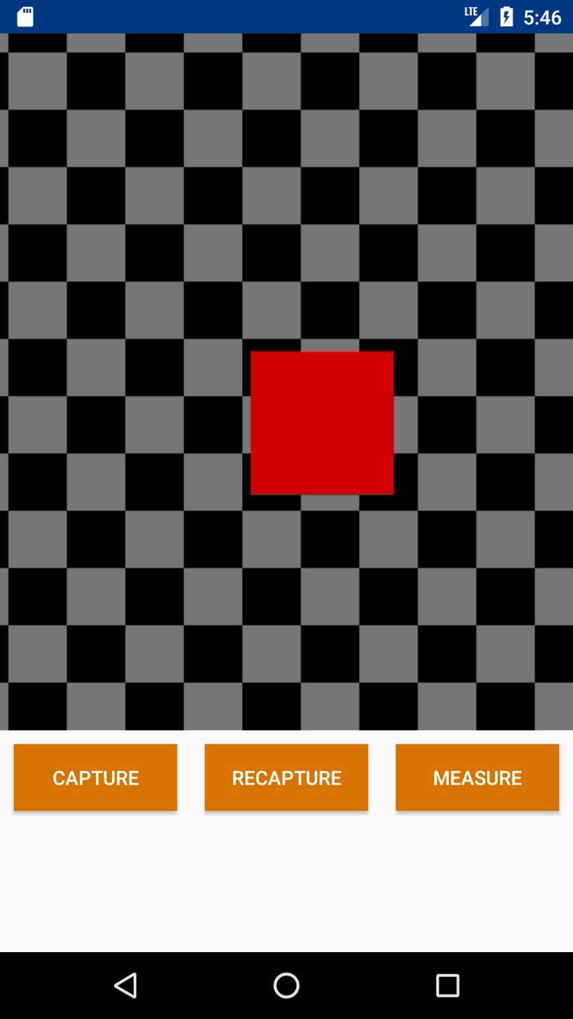
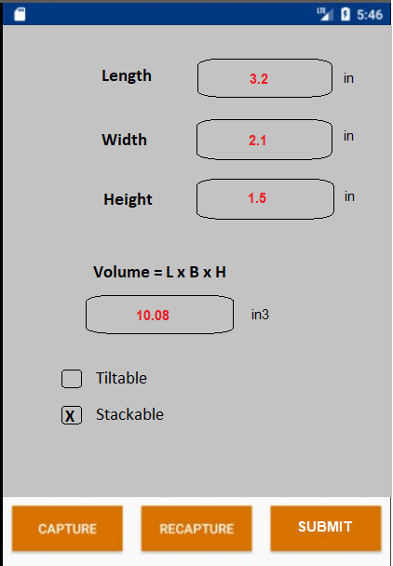
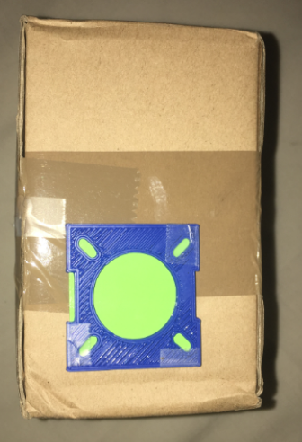
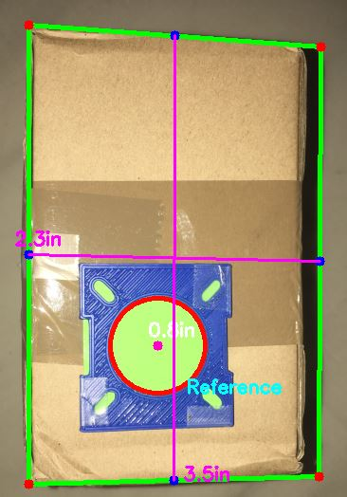
PROPOSED Solution
Processed Image
Sample Cargo
Take Photo
Sample Cargo
Take Photo
Result Page
Processed Image

Slide 4
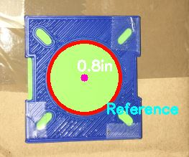




Image Processing
Comparing dimension
for known object
Finding Reference object
using Color filtering
Finding Edges in original
image for box shape
Input Image
Measure dimension
for box

Slide 5
Technology Stack
Image Processing - Python
Mobile App - Android
Server - Python Socket

Slide 6
Limitation and Future Scope
Conditions for best calculations –
Background should be relatively plain, contrasting in color (to the object).
The object stands separated from other objects and image edges.
Currently only tested for cuboid boxes.
Future Scope –
Instead of using current Analytical approach can use Data driven approach for learning various shapes and color.
All processing can be done locally on mobile station.

Slide 7
Thankyou
Naitik Shukla
Naval Kumar
Vignesh Srinivasan
Team@ISS

